Slide 1

Chapter 9 – Software Evolution
Chapter 9 Software evolution

Slide 2
Software change
Software change is inevitable
New requirements emerge when the software is used;
The business environment changes;
Errors must be repaired;
New computers and equipment is added to the system;
The performance or reliability of the system may have to be improved.
A key problem for all organizations is implementing and managing change to their existing software systems.
Chapter 9 Software evolution

Slide 3
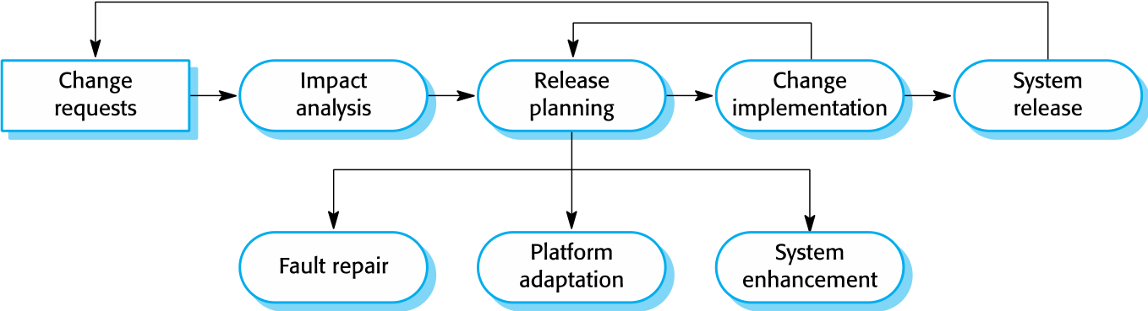
The software evolution process
Chapter 9 Software evolution

Slide 4
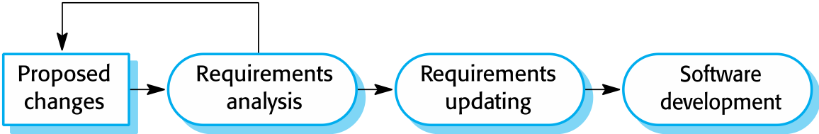
Change implementation
Chapter 9 Software evolution

Slide 5
Change implementation
Iteration of the development process where the revisions to the system are designed, implemented and tested.
A critical difference is that the first stage of change implementation may involve program understanding, especially if the original system developers are not responsible for the change implementation.
During the program understanding phase, you have to understand how the program is structured, how it delivers functionality and how the proposed change might affect the program.
Chapter 9 Software evolution

Slide 6
Program evolution dynamics
Program evolution dynamics is the study of the processes of system change.
After several major empirical studies, Lehman and Belady proposed that there were a number of ‘laws’ which applied to all systems as they evolved.
There are sensible observations rather than laws. They are applicable to large systems developed by large organisations.
It is not clear if these are applicable to other types of software system.
Chapter 9 Software evolution

Slide 7
Lehman’s laws
Law | Description
Continuing change | A program that is used in a real-world environment must necessarily change, or else become progressively less useful in that environment.
Increasing complexity | As an evolving program changes, its structure tends to become more complex. Extra resources must be devoted to preserving and simplifying the structure.
Large program evolution | Program evolution is a self-regulating process. System attributes such as size, time between releases, and the number of reported errors is approximately invariant for each system release.
Organizational stability | Over a program’s lifetime, its rate of development is approximately constant and independent of the resources devoted to system development.
Chapter 9 Software evolution

Slide 8
Lehman’s laws
Law | Description
Conservation of familiarity | Over the lifetime of a system, the incremental change in each release is approximately constant.
Continuing growth | The functionality offered by systems has to continually increase to maintain user satisfaction.
Declining quality | The quality of systems will decline unless they are modified to reflect changes in their operational environment.
Feedback system | Evolution processes incorporate multiagent, multiloop feedback systems and you have to treat them as feedback systems to achieve significant product improvement.
Chapter 9 Software evolution

Slide 9
Applicability of Lehman’s laws
Lehman’s laws seem to be generally applicable to large, tailored systems developed by large organisations.
Confirmed in early 2000’s by work by Lehman on the FEAST project.
It is not clear how they should be modified for
Shrink-wrapped software products;
Systems that incorporate a significant number of COTS components;
Small organisations;
Medium sized systems.
Chapter 9 Software evolution

Slide 10
Software maintenance
Modifying a program after it has been put into use.
The term is mostly used for changing custom software. Generic software products are said to evolve to create new versions.
Maintenance does not normally involve major changes to the system’s architecture.
Changes are implemented by modifying existing components and adding new components to the system.
Chapter 9 Software evolution

Slide 11
Types of maintenance
Maintenance to repair software faults
Changing a system to correct deficiencies in the way meets its requirements.
Maintenance to adapt software to a different operating environment
Changing a system so that it operates in a different environment (computer, OS, etc.) from its initial implementation.
Maintenance to add to or modify the system’s functionality
Modifying the system to satisfy new requirements.
Chapter 9 Software evolution

Slide 12
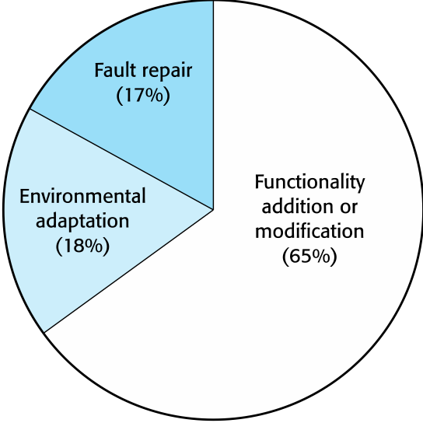
Figure 9.8 Maintenance effort distribution
Chapter 9 Software evolution

Slide 13
Maintenance costs
Usually greater than development costs (2* to 100* depending on the application).
Affected by both technical and non-technical factors.
Increases as software is maintained. Maintenance corrupts the software structure so makes further maintenance more difficult.
Ageing software can have high support costs (e.g. old languages, compilers etc.).
Chapter 9 Software evolution

Slide 14
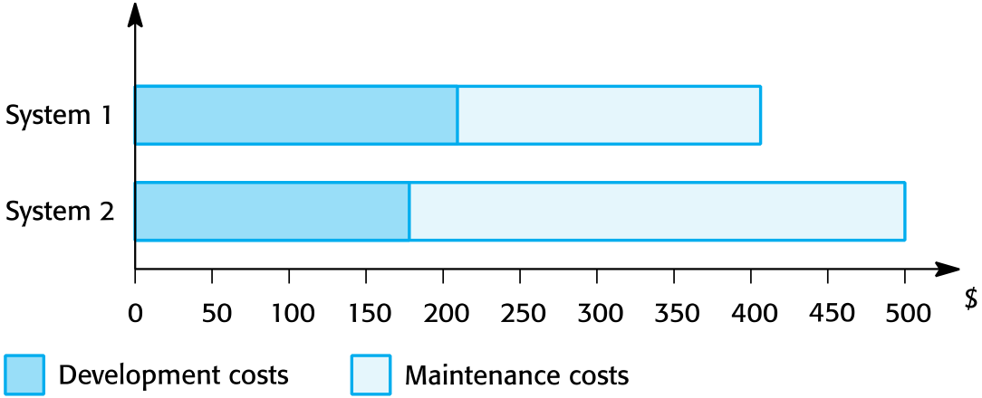
Figure 9.9 Development and maintenance costs
Chapter 9 Software evolution

Slide 15
Maintenance cost factors
Team stability
Maintenance costs are reduced if the same staff are involved with them for some time.
Contractual responsibility
The developers of a system may have no contractual responsibility for maintenance so there is no incentive to design for future change.
Staff skills
Maintenance staff are often inexperienced and have limited domain knowledge.
Program age and structure
As programs age, their structure is degraded and they become harder to understand and change.
Chapter 9 Software evolution

Slide 16
Complexity metrics
Predictions of maintainability can be made by assessing the complexity of system components.
Studies have shown that most maintenance effort is spent on a relatively small number of system components.
Complexity depends on
Complexity of control structures;
Complexity of data structures;
Object, method (procedure) and module size.
Chapter 9 Software evolution

Slide 17
System re-engineering
Re-structuring or re-writing part or all of a legacy system without changing its functionality.
Applicable where some but not all sub-systems of a larger system require frequent maintenance.
Re-engineering involves adding effort to make them easier to maintain. The system may be re-structured and re-documented.
Chapter 9 Software evolution

Slide 18
Advantages of reengineering
Reduced risk
There is a high risk in new software development. There may be development problems, staffing problems and specification problems.
Reduced cost
The cost of re-engineering is often significantly less than the costs of developing new software.
Chapter 9 Software evolution

Slide 19
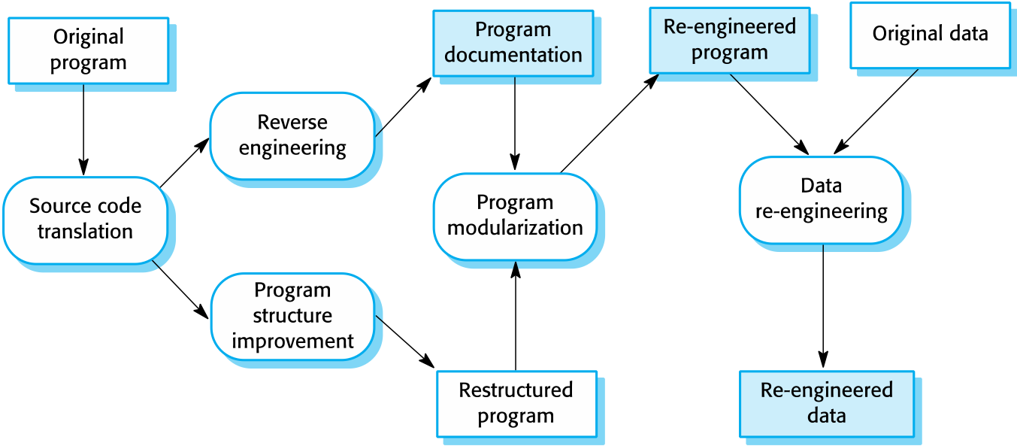
The reengineering process
Chapter 9 Software evolution

Slide 20
Reengineering process activities
Source code translation
Convert code to a new language.
Reverse engineering
Analyse the program to understand it;
Program structure improvement
Restructure automatically for understandability;
Program modularisation
Reorganise the program structure;
Data reengineering
Clean-up and restructure system data.
Chapter 9 Software evolution

Slide 21
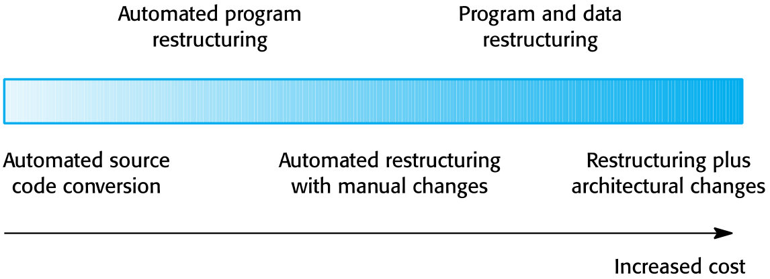
Figure 9.12 Reengineering approaches
Chapter 9 Software evolution

Slide 22
Preventative maintenance by refactoring
Refactoring is the process of making improvements to a program to slow down degradation through change.
You can think of refactoring as ‘preventative maintenance’ that reduces the problems of future change.
Refactoring involves modifying a program to improve its structure, reduce its complexity or make it easier to understand.
When you refactor a program, you should not add functionality but rather concentrate on program improvement.
Chapter 9 Software evolution

Slide 23
‘Bad smells’ in program code
Duplicate code
The same or very similar code may be included at different places in a program. This can be removed and implemented as a single method or function that is called as required.
Long methods
If a method is too long, it should be redesigned as a number of shorter methods.
Switch (case) statements
These often involve duplication, where the switch depends on the type of a value. The switch statements may be scattered around a program. In object-oriented languages, you can often use polymorphism to achieve the same thing.
Chapter 9 Software evolution

Slide 24
‘Bad smells’ in program code
Data clumping
Data clumps occur when the same group of data items (fields in classes, parameters in methods) re-occur in several places in a program. These can often be replaced with an object that encapsulates all of the data.
Speculative generality
This occurs when developers include generality in a program in case it is required in the future. This can often simply be removed.
Chapter 9 Software evolution

Slide 25
Legacy system management
Organisations that rely on legacy systems must choose a strategy for evolving these systems
Scrap the system completely and modify business processes so that it is no longer required;
Continue maintaining the system;
Transform the system by re-engineering to improve its maintainability;
Replace the system with a new system.
The strategy chosen should depend on the system quality and its business value.
Chapter 9 Software evolution

Slide 26
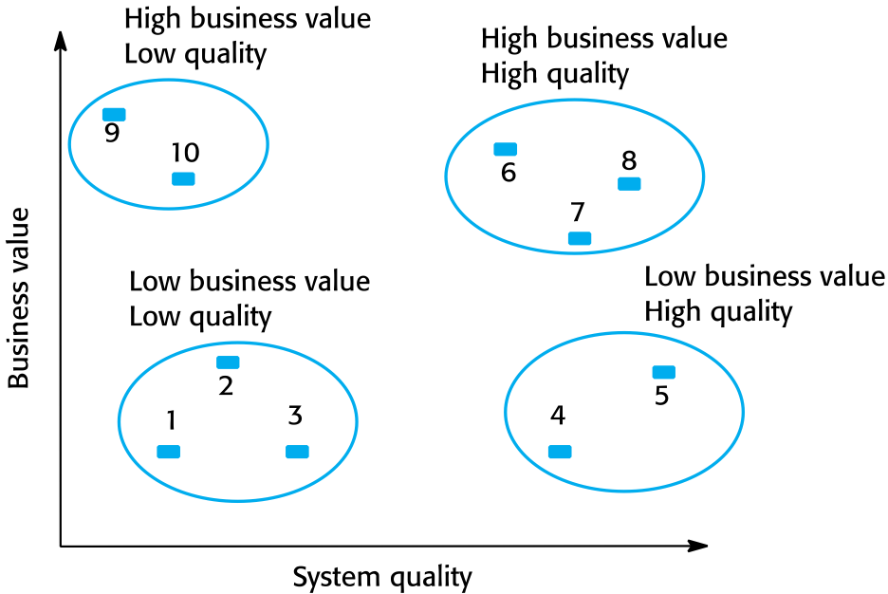
Figure 9.13 An example of a legacy system assessment
Chapter 9 Software evolution

Slide 27
Legacy system categories
Low quality, low business value
These systems should be scrapped.
Low-quality, high-business value
These make an important business contribution but are expensive to maintain. Should be re-engineered or replaced if a suitable system is available.
High-quality, low-business value
Replace with COTS, scrap completely or maintain.
High-quality, high business value
Continue in operation using normal system maintenance.
Chapter 9 Software evolution

Slide 28
Business value assessment
Assessment should take different viewpoints into account
System end-users;
Business customers;
Line managers;
IT managers;
Senior managers.
Interview different stakeholders and collate results.
Chapter 9 Software evolution

Slide 29
Issues in business value assessment
The use of the system
If systems are only used occasionally or by a small number of people, they may have a low business value.
The business processes that are supported
A system may have a low business value if it forces the use of inefficient business processes.
System dependability
If a system is not dependable and the problems directly affect business customers, the system has a low business value.
The system outputs
If the business depends on system outputs, then the system has a high business value.
Chapter 9 Software evolution

Slide 30
System quality assessment
Environment assessment
How effective is the system’s environment and how expensive is it to maintain?
Application assessment
What is the quality of the application software system?
Chapter 9 Software evolution

Slide 31
Factors used in environment assessment
Factor | Questions
Supplier stability | Is the supplier still in existence? Is the supplier financially stable and likely to continue in existence? If the supplier is no longer in business, does someone else maintain the systems?
Failure rate | Does the hardware have a high rate of reported failures? Does the support software crash and force system restarts?
Age | How old is the hardware and software? The older the hardware and support software, the more obsolete it will be. It may still function correctly but there could be significant economic and business benefits to moving to a more modern system.
Performance | Is the performance of the system adequate? Do performance problems have a significant effect on system users?
Chapter 9 Software evolution

Slide 32
Factors used in environment assessment
Factor | Questions
Support requirements | What local support is required by the hardware and software? If there are high costs associated with this support, it may be worth considering system replacement.
Maintenance costs | What are the costs of hardware maintenance and support software licences? Older hardware may have higher maintenance costs than modern systems. Support software may have high annual licensing costs.
Interoperability | Are there problems interfacing the system to other systems? Can compilers, for example, be used with current versions of the operating system? Is hardware emulation required?
Chapter 9 Software evolution

Slide 33
System measurement
You may collect quantitative data to make an assessment of the quality of the application system
The number of system change requests;
The number of different user interfaces used by the system;
The volume of data used by the system.
Chapter 9 Software evolution

Slide 34
Key points
Software development and evolution can be thought of as an integrated, iterative process that can be represented using a spiral model.
For custom systems, the costs of software maintenance usually exceed the software development costs.
The process of software evolution is driven by requests for changes and includes change impact analysis, release planning and change implementation.
Lehman’s laws, such as the notion that change is continuous, describe a number of insights derived from long-term studies of system evolution.
Chapter 9 Software evolution

Slide 35
Key points
There are 3 types of software maintenance, namely bug fixing, modifying software to work in a new environment, and implementing new or changed requirements.
Software re-engineering is concerned with re-structuring and re-documenting software to make it easier to understand and change.
Refactoring, making program changes that preserve functionality, is a form of preventative maintenance.
The business value of a legacy system and the quality of the application should be assessed to help decide if a system should be replaced, transformed or maintained.
Chapter 9 Software evolution

